Slide 1

EMPLOYEE ATTRITION
PREDICTION
AND
HR ANALYTICS
Team 3 - Members Adinanda T K
Arshad Arif M M
Prasanth K V
Sreeradha M

Slide 2

INDEX
Abstract
Problem Statement
Dataset
Conclusion

Slide 3
ABSTRACT
Employee attrition poses significant challenges for businesses, impacting productivity and continuity. In this project, we aim to develop a predictive system using HR analytics to identify employees at risk of leaving.
Our goal is to accurately predict employee attrition within an organization or team. We utilize a dataset of 4400 rows and 29 columns, including attributes such as age, job role, job satisfaction, work-life balance, and performance rating.
Leveraging machine learning algorithms like logistic regression, decision trees, random forests, and gradient boosting, we conduct data preprocessing, feature engineering, model training, and performance evaluation.

Slide 4
ABSTRACT
The project's outcomes offer valuable insights empowering HR professionals to proactively identify employees at higher attrition risk. This enables the implementation of targeted retention strategies, such as personalized development plans and improved work-life balance initiatives.
The integration of employee attrition prediction and HR analytics holds immense potential in enhancing workforce management, fostering organizational growth, and ensuring overall success. The project highlights the significance of data-driven decision-making in HR practices and employee retention strategies.

Slide 5
PROBLEM STATEMENT
The system aims to develop a predictive model using employee data to forecast attrition within an organization or team, enabling proactive measures to address retention challenges.
It leverages data-driven decision-making to provide actionable insights for implementing targeted strategies that reduce employee attrition and enhance workforce management.

Slide 6
DATASET
The dataset is a valuable resource for data science projects focused on HR analytics and predicting employee attrition.
It contains crucial attributes related to employees, including:
Age : Numeric (integer)
Business Travel : Categorical (string)
Department : Categorical (string)
Education : Ordinal (integer)
Job Role : Categorical (string)
Marital Status : Categorical (string)
Salary : Numeric (integer)

Slide 7
DATASET
The main target variable, “Attrition”, is a binary indicator that determines whether an employee has left the organization or not. It is represented as a categorical variable with values like “Yes” or “No”.
By exploring this dataset and applying data-driven decision-making techniques, it offers insights into factors that may contribute to employee attrition.
The ultimate goal of using this dataset is to build a predictive model that can forecast potential attrition within the organization, enabling proactive measures to retain valuable employees and foster a positive work environment.

Slide 8
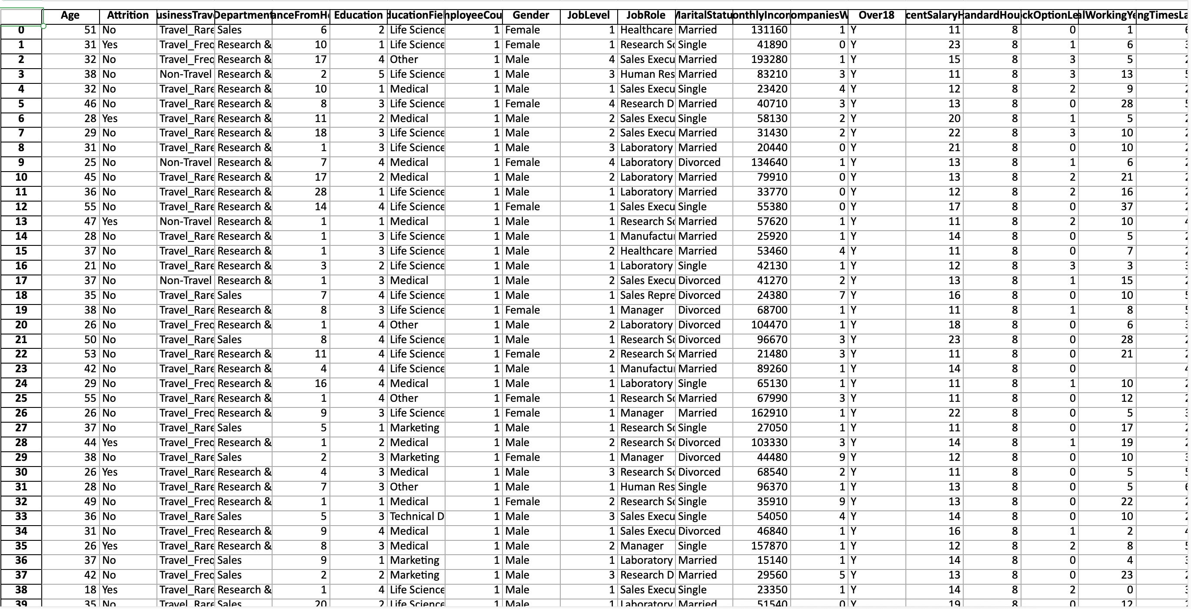
DATASET

Slide 9
EXPLORATORY DATA ANALYSIS

Slide 10
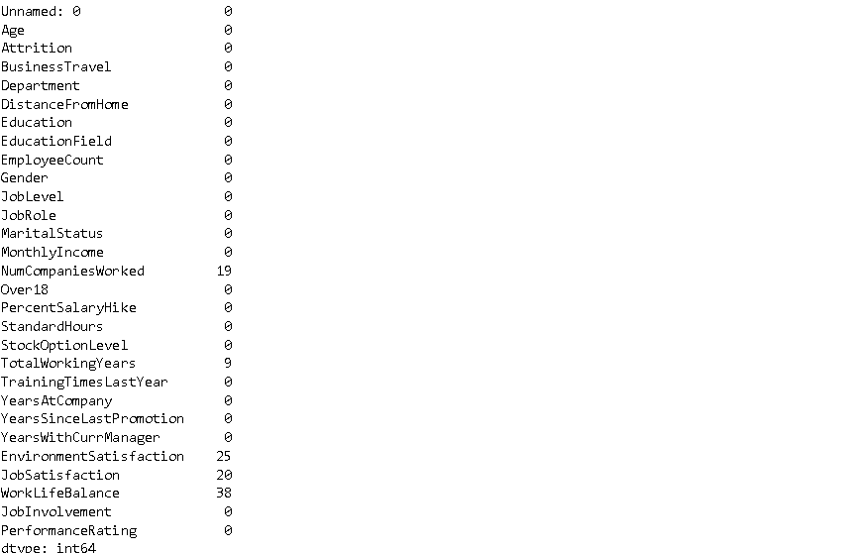
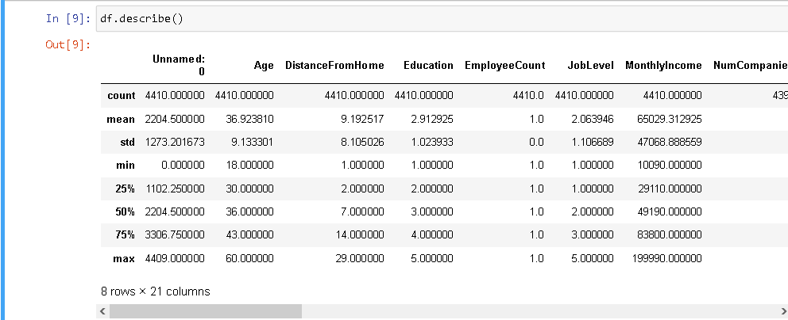
df.describe()
df.isnull().sum()

Slide 11
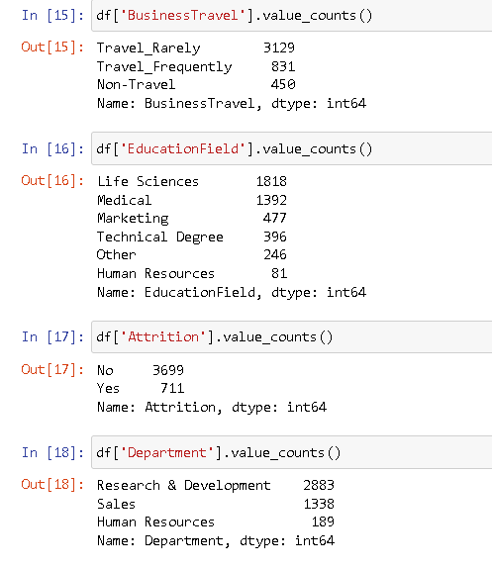
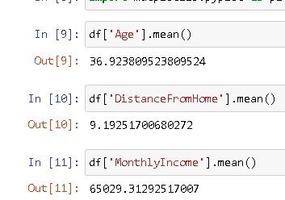
Mean of Important Cloumns
Value Counts of Important columns

Slide 12
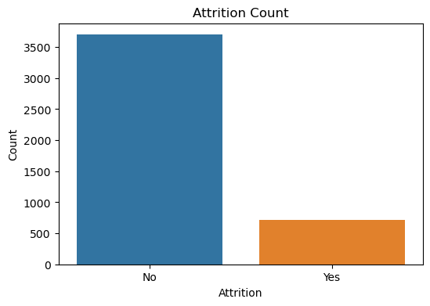

Slide 13
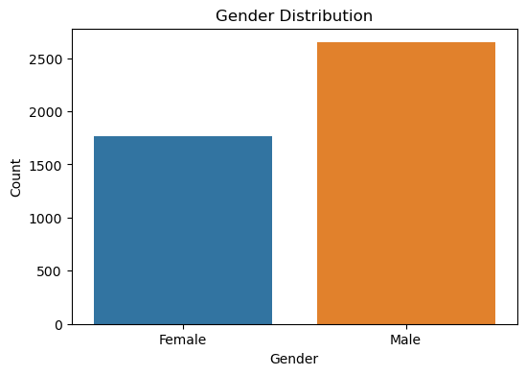

Slide 14
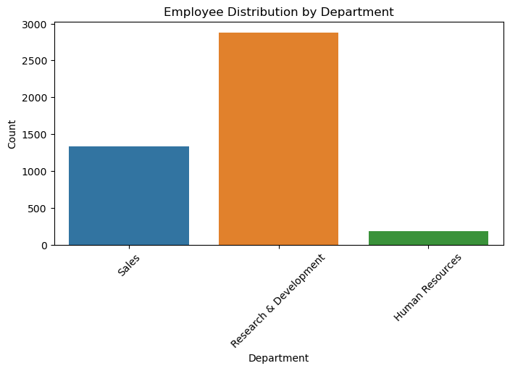

Slide 15
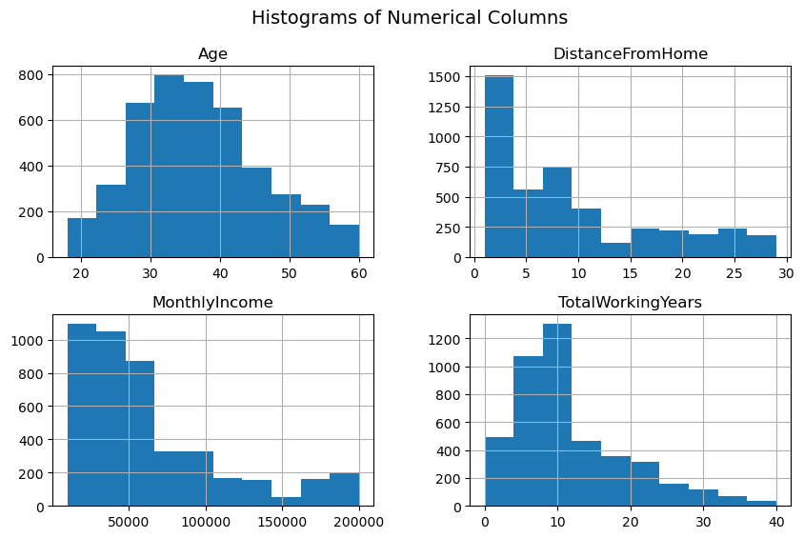

Slide 16
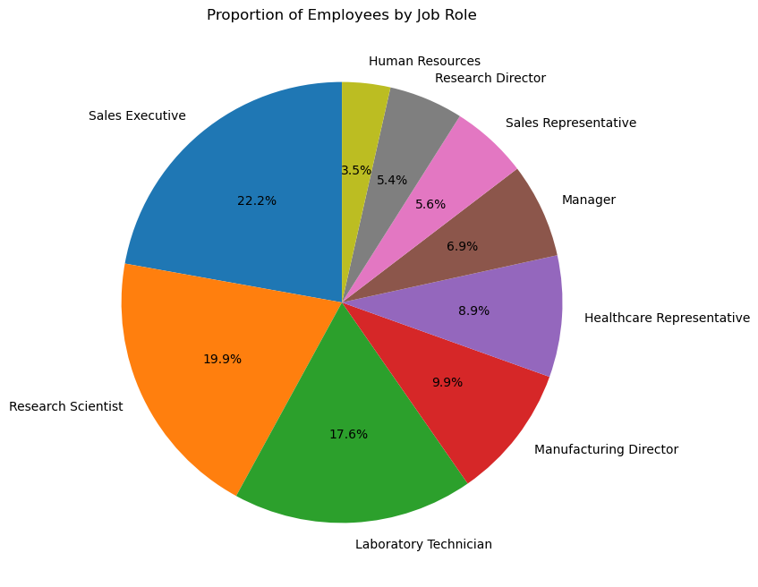

Slide 17
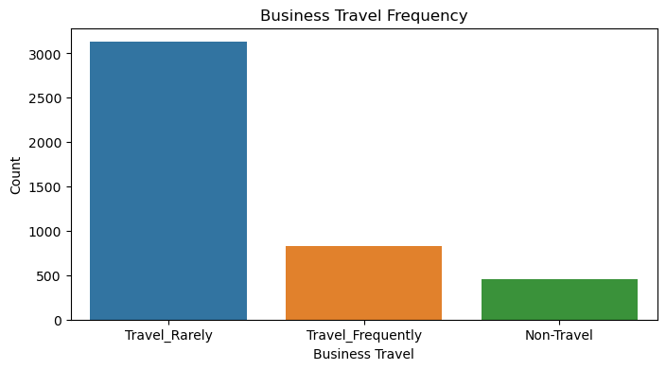

Slide 18
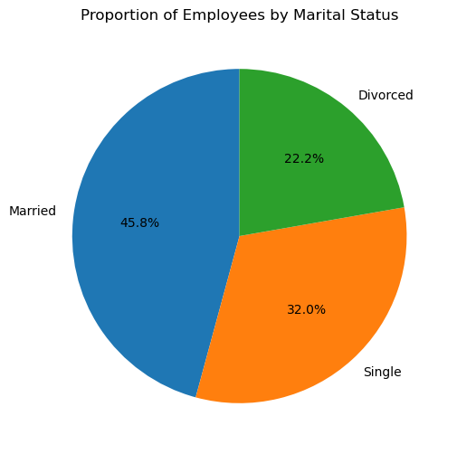

Slide 19
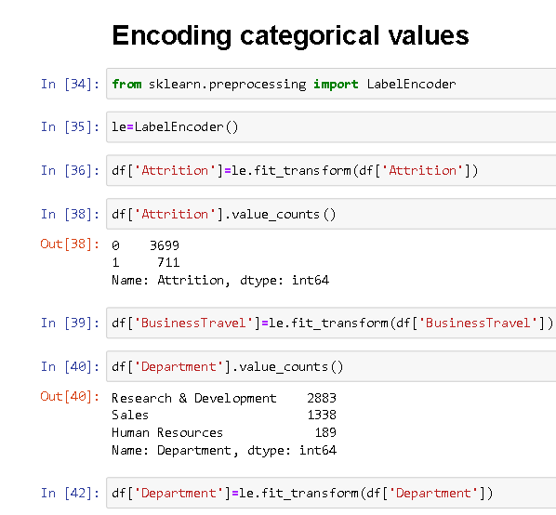

Slide 20
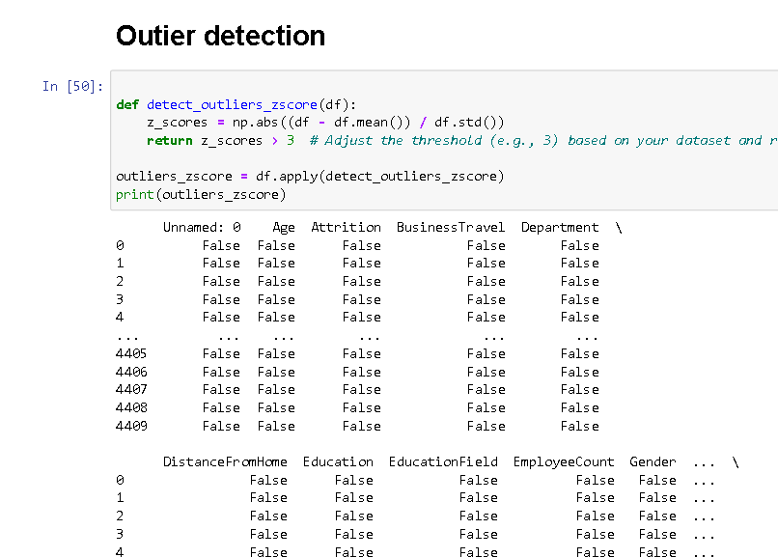

Slide 21
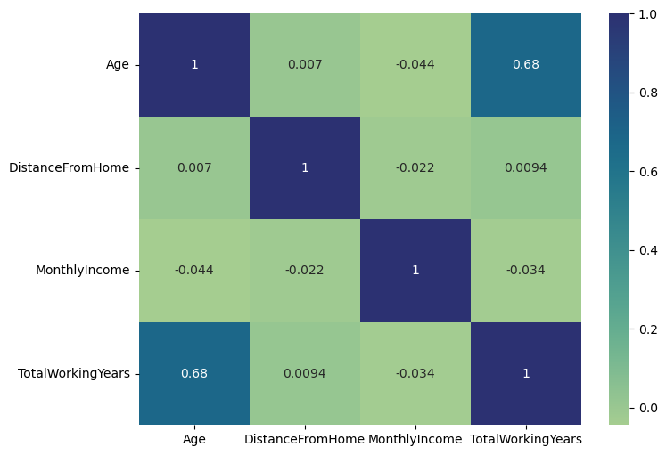

Slide 22
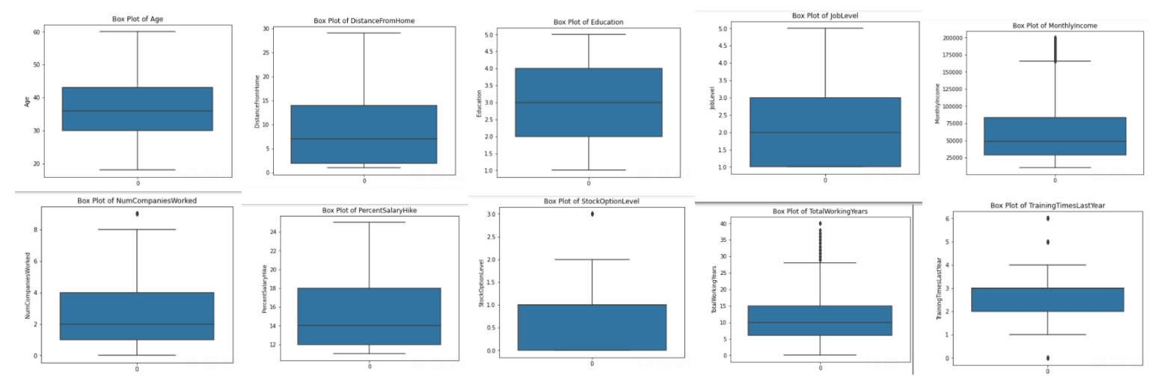
BOX PLOT

Slide 23
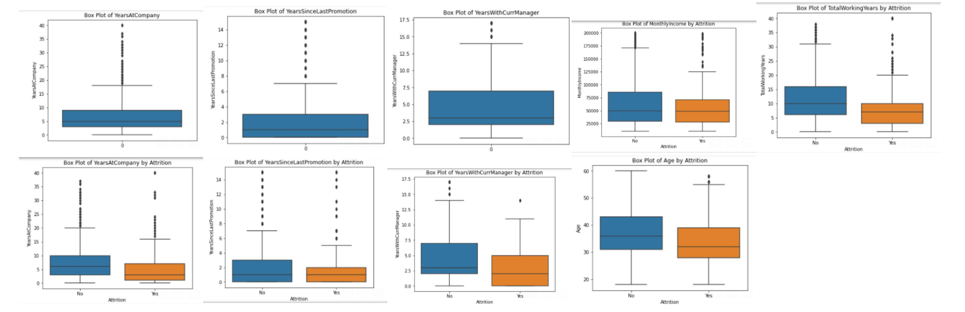

Slide 24
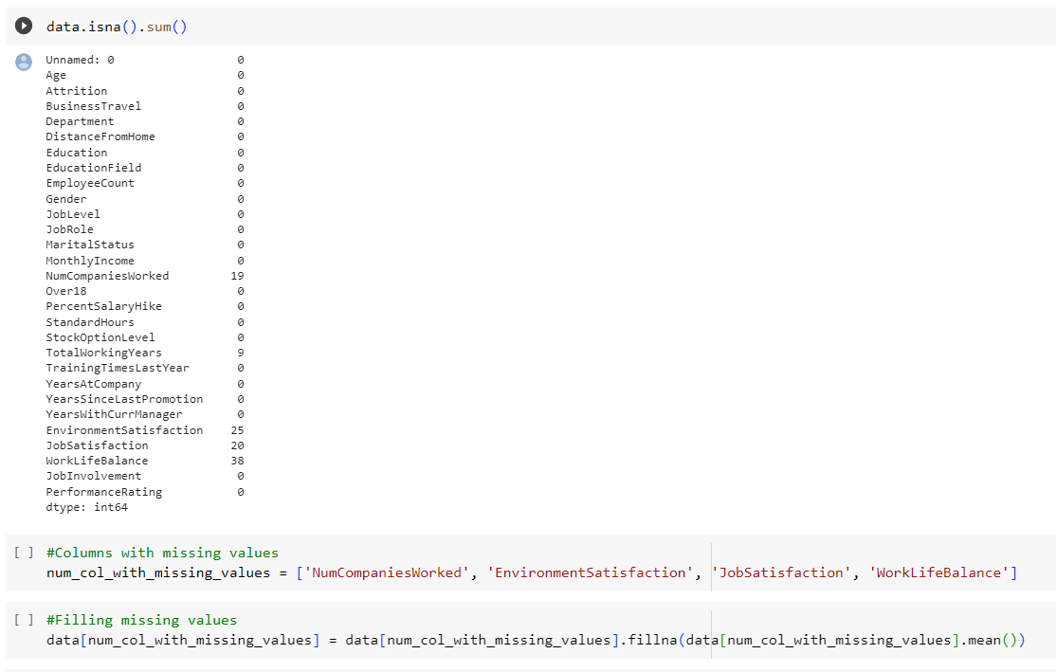
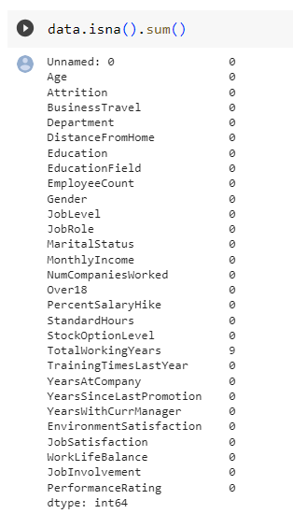
FIND AND RESOLVE THE MISSING VALUES

Slide 25
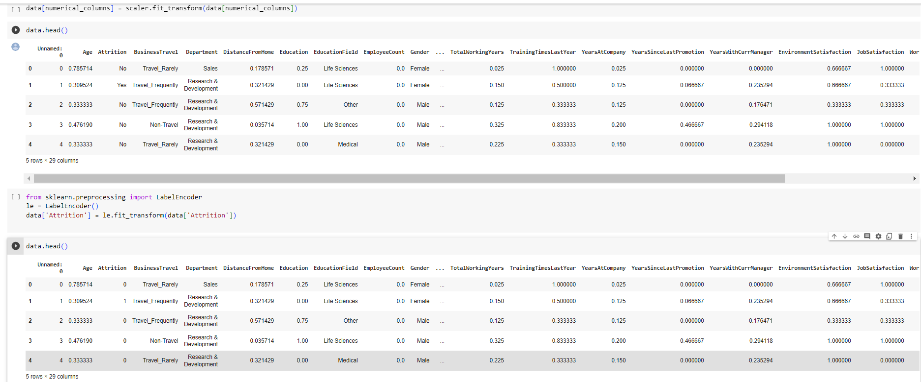
SCALING AND NORMALIZATION

Slide 26
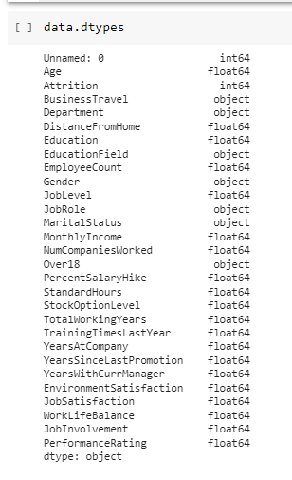

Slide 27
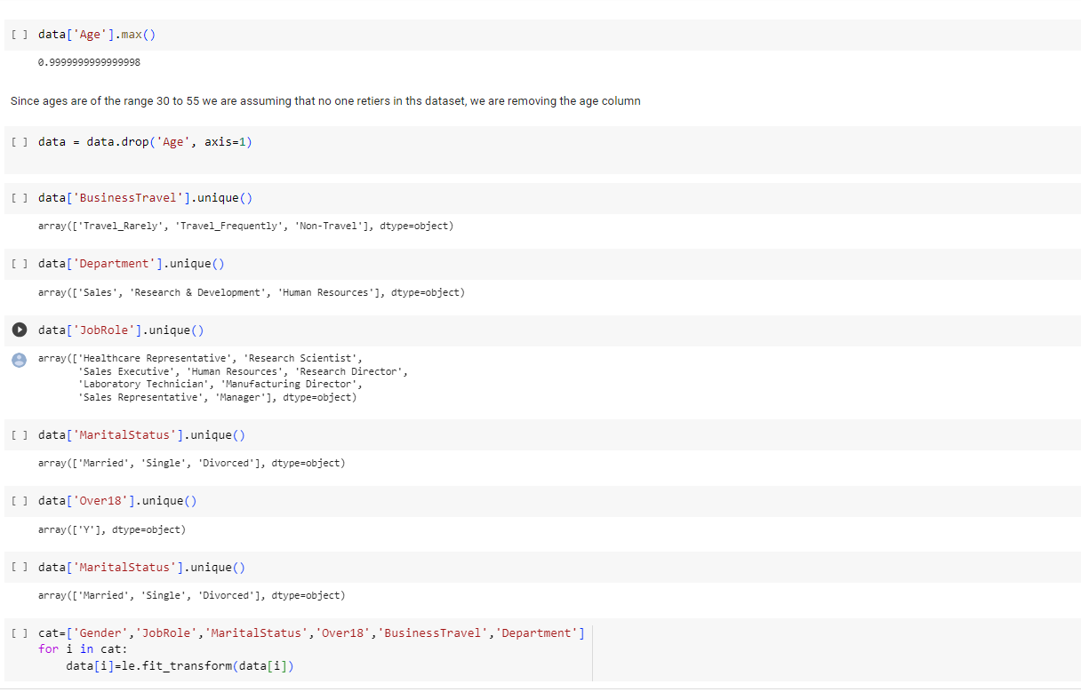
FEATURE SELECTION / ENGINEERING

Slide 28
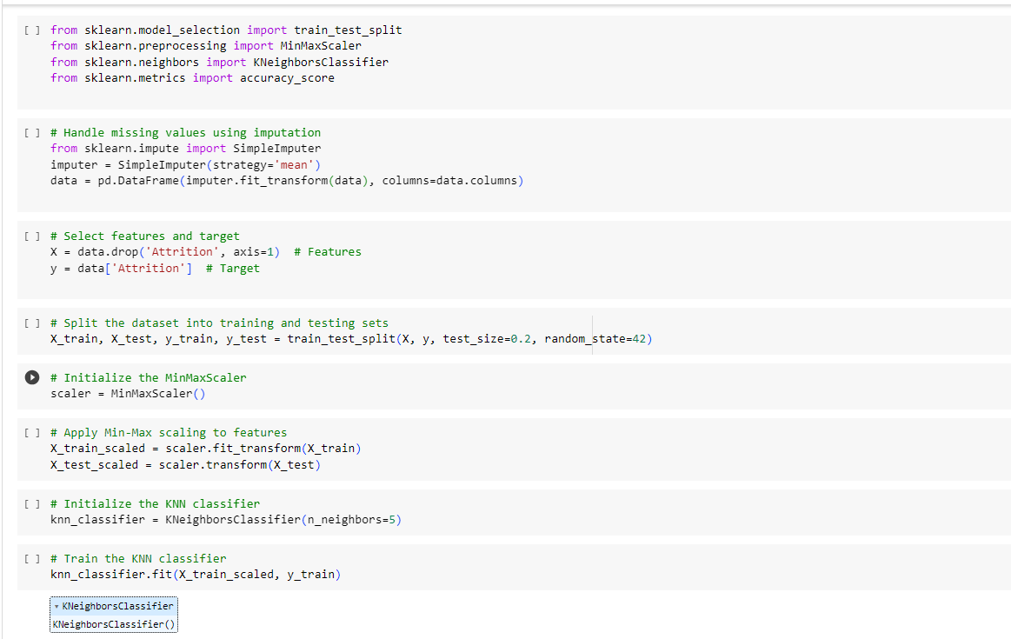
PERFORMING KNN CLASSIFIER

Slide 29
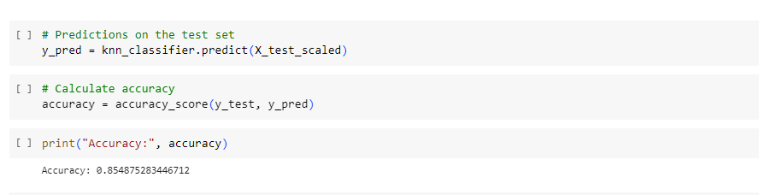
PERFORMING KNN CLASSIFIER
We got the accuracy of 0.85 in KNN Classifier

Slide 30
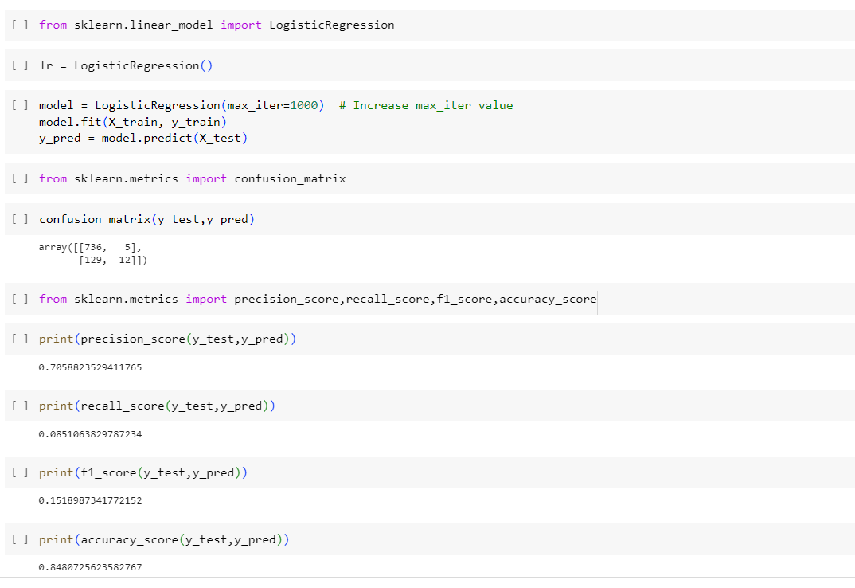
PERFORMING LOGISTIC REGRESSION
We got the accuracy of 0.84 in Logistic Regression

Slide 31
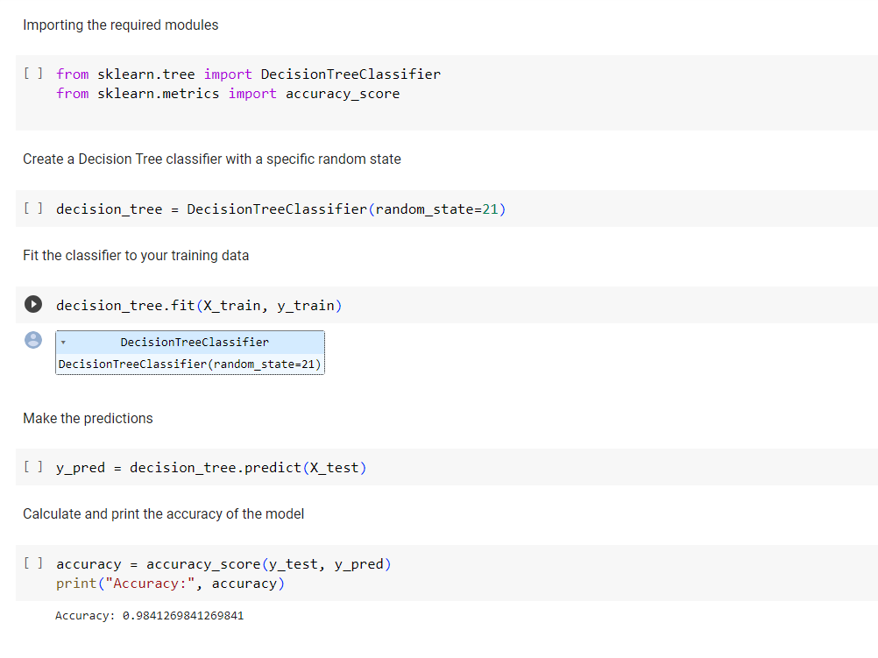
PERFORMING DECISION TREE
We got a very good accuracy of 0.98 in Decision Tree

Slide 32
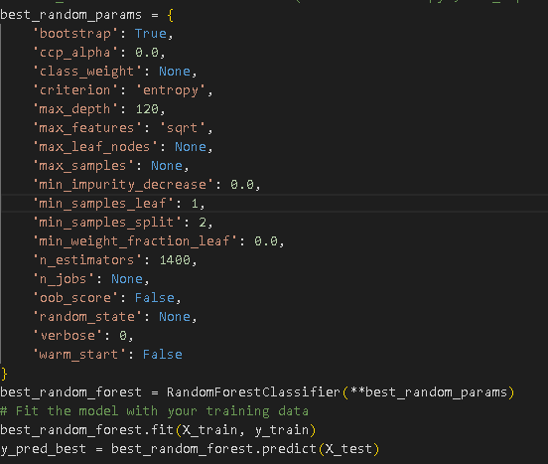
HYPERPARAMETER TUNING
We got the accuracy of 0.99 in Random Forest

Slide 33
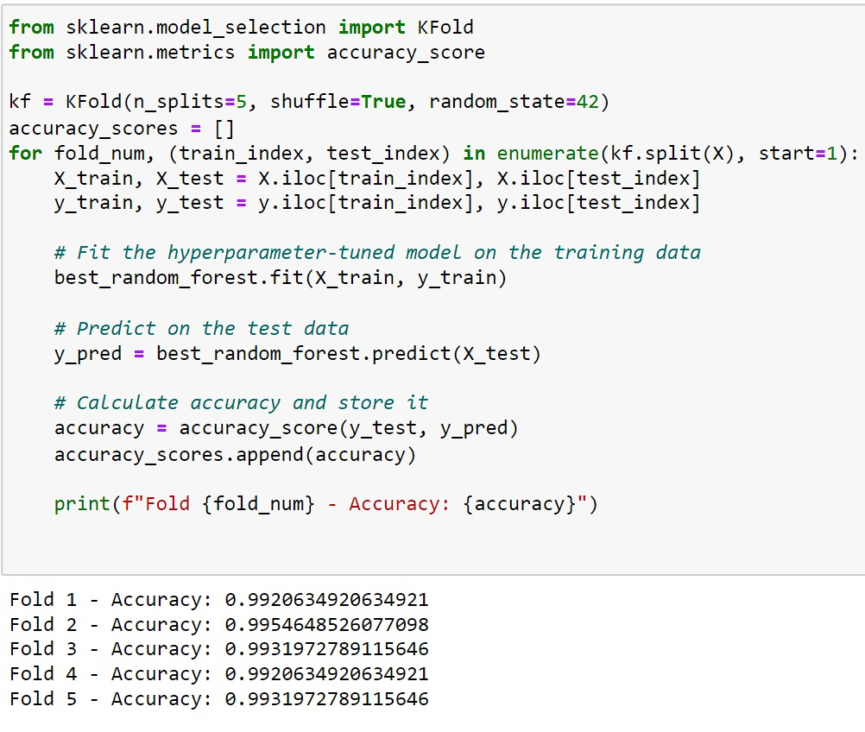
K-Fold Cross Validation

Slide 34
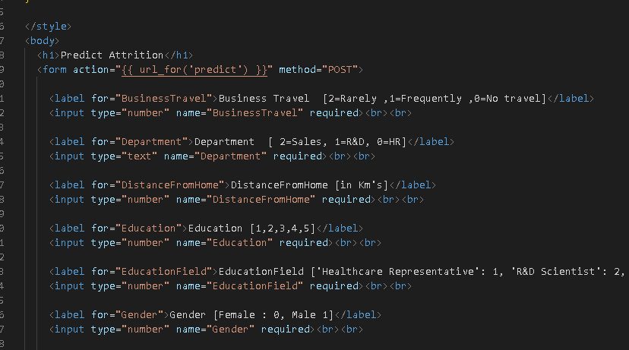
MODEL DEPLOYMENT
HTML code for index page

Slide 35
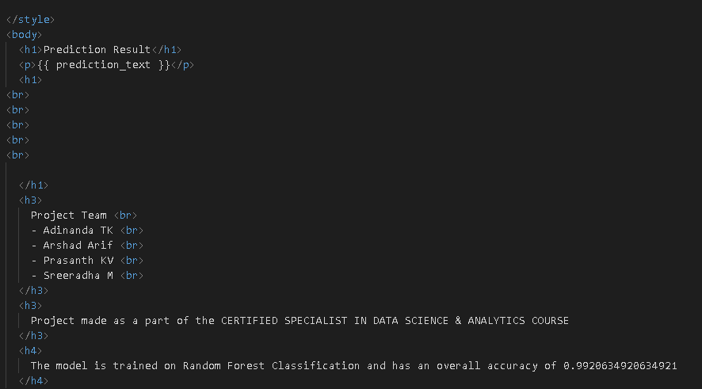
MODEL DEPLOYMENT
HTML code for result page

Slide 36
MODEL DEPLOYMENT
Backend -Flask

Slide 37
Test - Train validation
On External data
On Internal data

Slide 38
RESULT

Slide 39
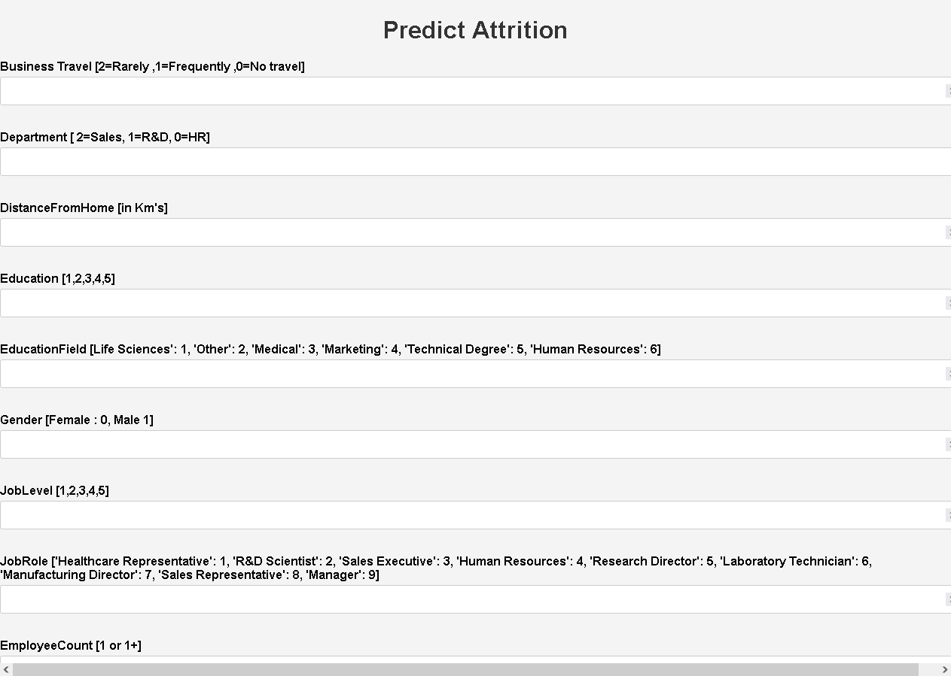

Slide 40
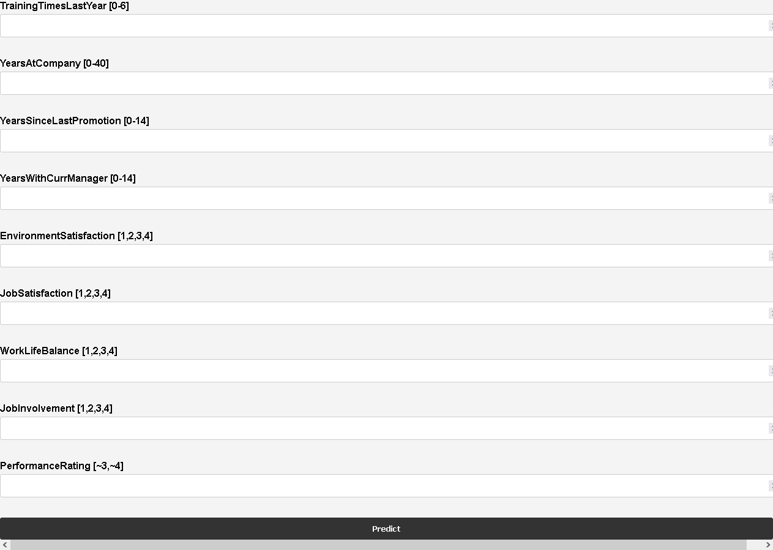

Slide 41
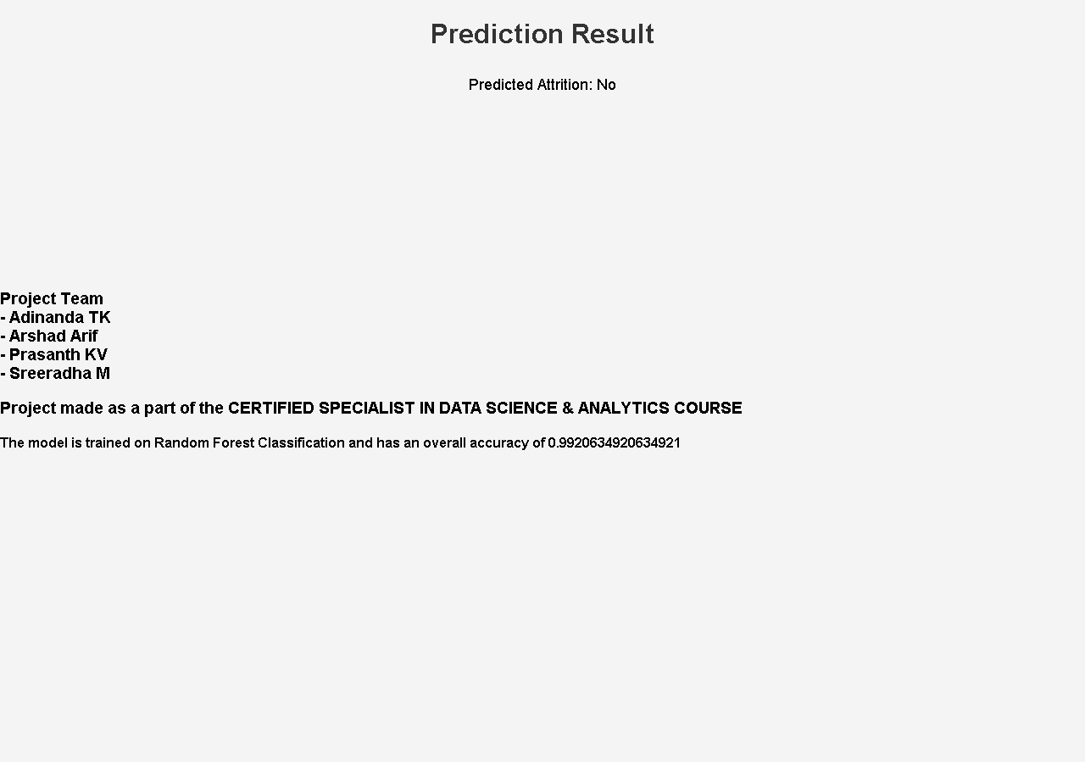

Slide 42
https://hrattritionteam3.pythonanywhere.com/

Slide 43
CONCLUSION
The developed system for predicting employee attrition and employing data-driven decision-making offers valuable insights and proactive measures to tackle retention challenges within the organization or team.
By leveraging historical employee data, the system enables the implementation of targeted strategies that can reduce attrition rates and improve overall workforce management, leading to a more stable and productive work environment.

Slide 44
THANK YOU

